Slide 1
Activation Functions
Presented by Daniel Gordon

Slide 2
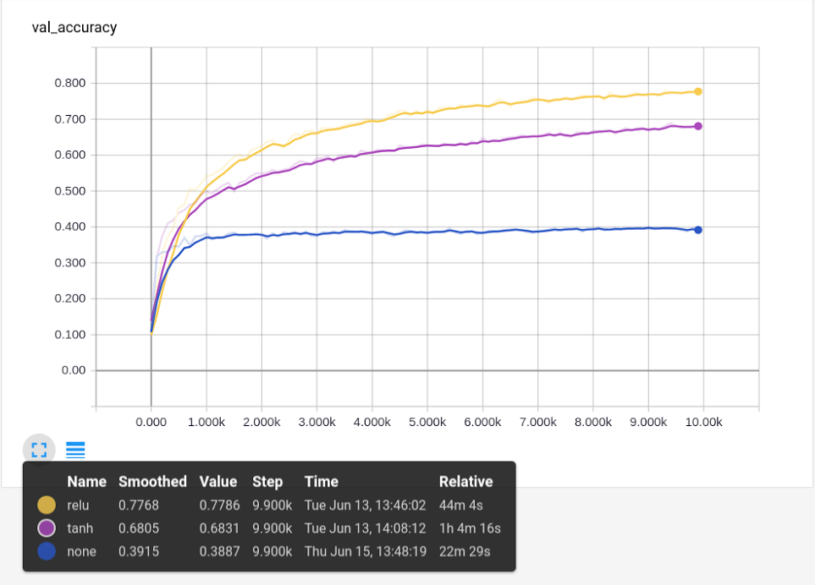
The Why
A linear combination of a linear combination is a linear combination
Any N layer network with no non-linearities can be represented by a single layer.

Slide 3
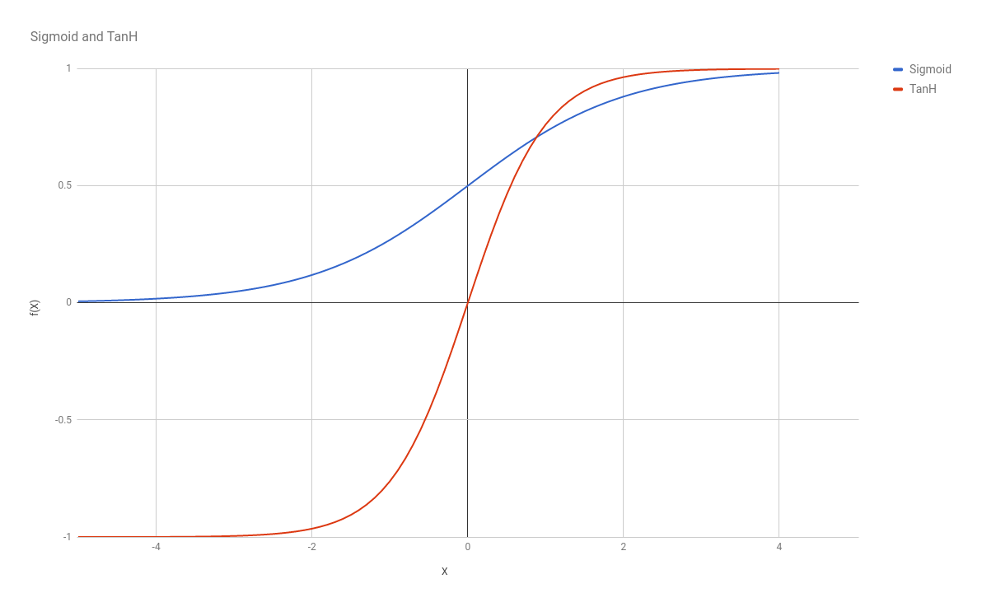
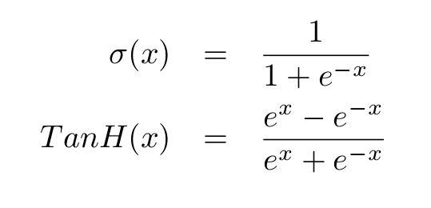
The Old Defaults

Slide 4
Problems
Zero gradient pretty much everywhere
Causes vanishing gradient when layers are stacked

Slide 5

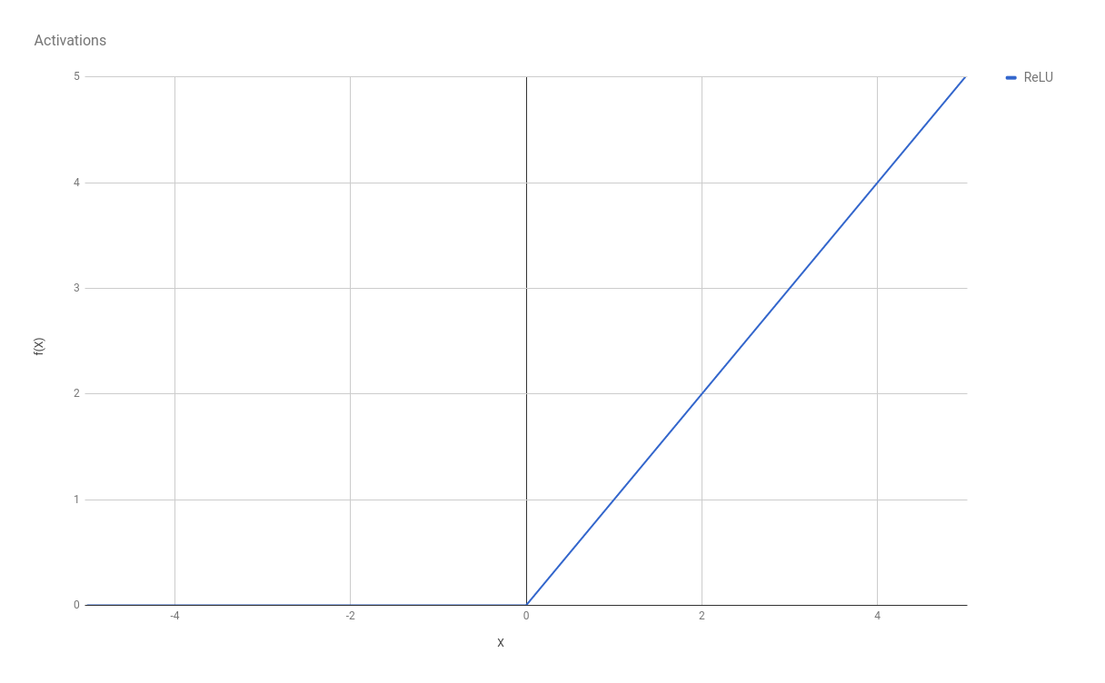
ReLU: The “new” Default
Notes:
Why ReLU makes sense:
Stops the vanishing gradient in the positive side
Robust to outliers on the negative side
Can be computed quickly and in-place
Linear seems easier to optimize
Induces sparsity in the outputs which can be good

Slide 6
Problems
Zero gradient in half the places
Outputs are not zero-mean (leads to bias shift)
Not smooth

Slide 7
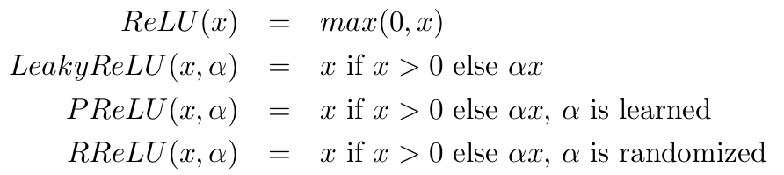
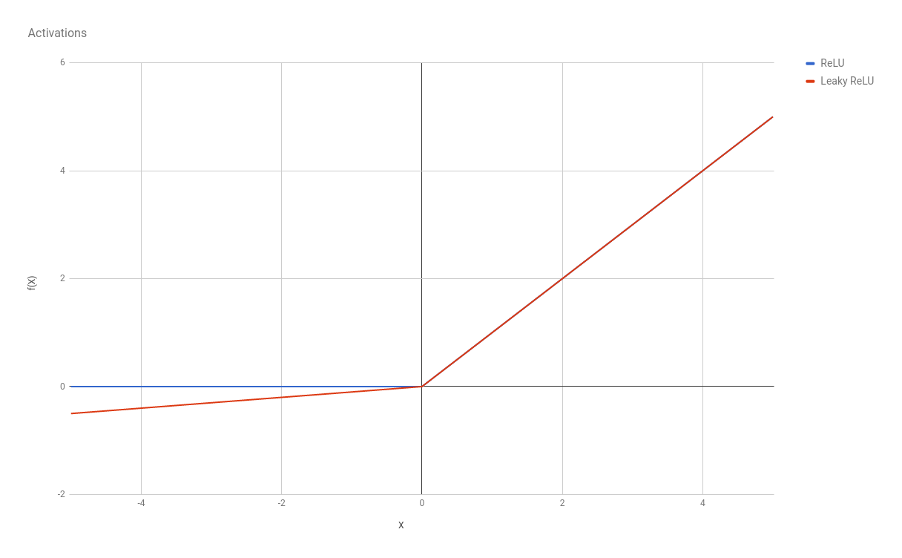
The Leaky ReLU Family

Slide 8
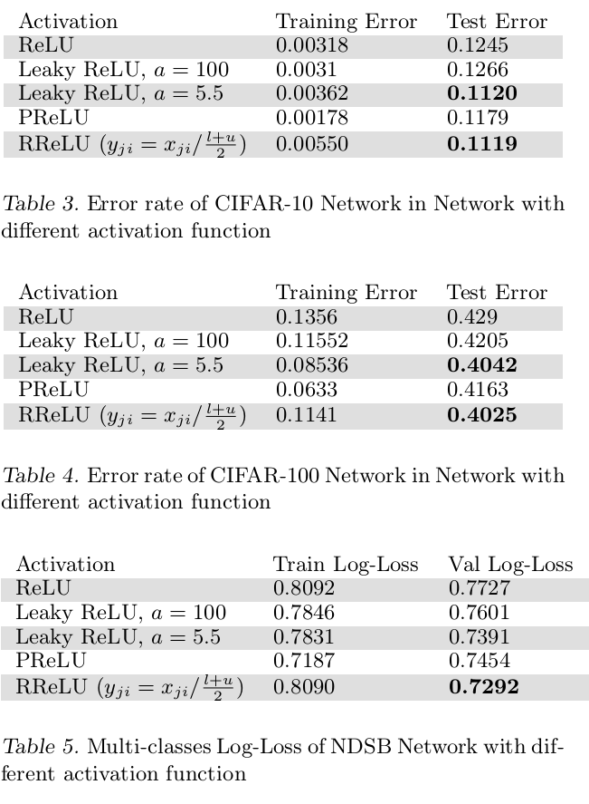
Empirical Evaluation of Rectified Activations in Convolution Network

Slide 9
Leaky ReLU in TF (slow, lots of memory)
with tf.variable_scope('lrelu'): output = tf.maximum(input, slope * input)

Slide 10
Leaky ReLU in TF (slightly better)
with tf.variable_scope('lrelu'):
f1 = 0.5 * (1 + slope)
f2 = 0.5 * (1 - slope)
output = f1 * input + f2 * tf.abs(input)

Slide 11
Leaky ReLU in TF (best)
with tf.variable_scope('lrelu'): output = (tf.nn.relu(input) - slope *
tf.nn.relu(-input))

Slide 12
RReLU and PReLU in TF
if ACTIVATION_TYPE == 'rrelu': with tf.variable_scope('rrelu'): if train: slope = tf.random_uniform(shape=input.get_shape().as_list(), minval=1.0/8, maxval=1.0/3) else: slope = tf.fill(input.get_shape().as_list(), (1.0/8 + 1.0/3) / 2) output = tf.nn.relu(input) - slope * tf.nn.relu(-input)
elif ACTIVATION_TYPE == 'prelu': with tf.variable_scope(input.name[:-2] + '/prelu'): weights = tf.get_variable('prelu',
shape=input.get_shape().as_list()[-1],
dtype=tf.float32,initializer=tf.constant_initializer(0.25))
output = tf.nn.relu(input) - weights * tf.nn.relu(-input)
Notes:
RReLU is slow because it has to generate a random value for each input

Slide 13
The all-important hyperparameters
Leaky ReLU - set 𝛼 ← 0.01
PReLU - initialize 𝛼 ← 0.25
RReLU - set 𝛼 ←uniform(⅛, ⅓) resampled at every pass

Slide 14
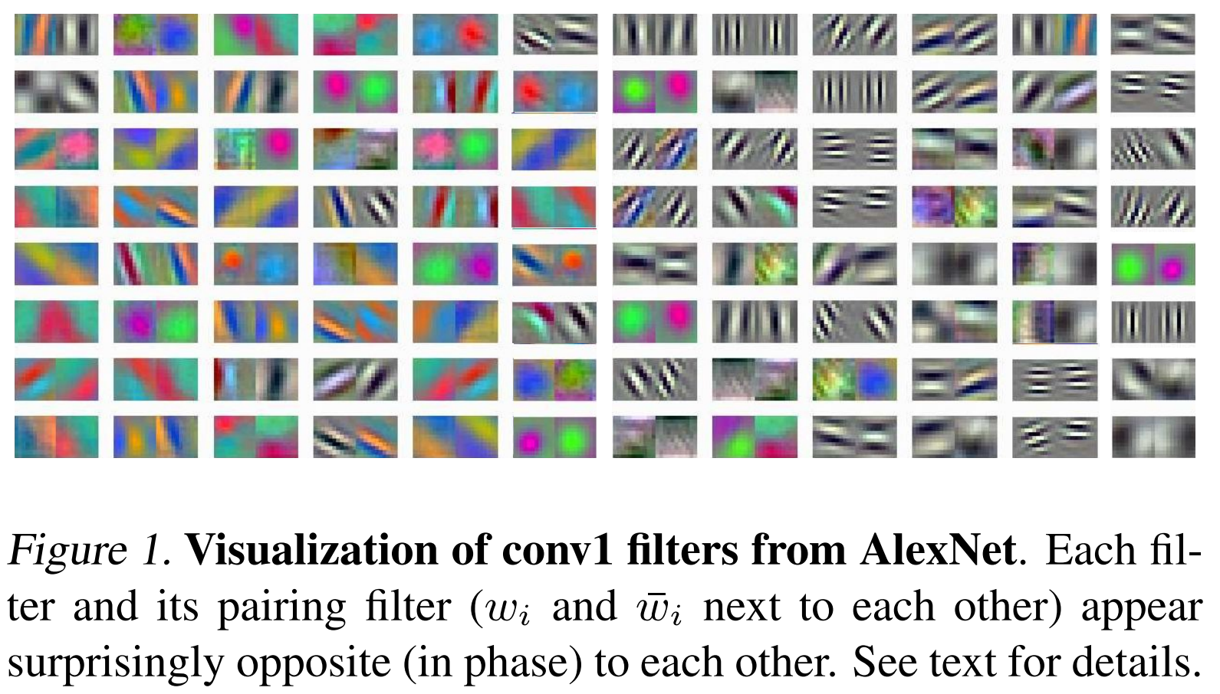
Another Problem: Similar but opposite

Slide 15
Another solution: Concatenated ReLUs
CReLU(x) = [ReLU(x) ; ReLU(-x)]
+ “Information Preserving”
- Output is 2x Input
Understanding and Improving Convolutional Neural Networks via Concatenated Rectified Linear Units

Slide 16
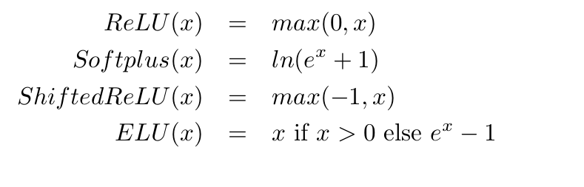
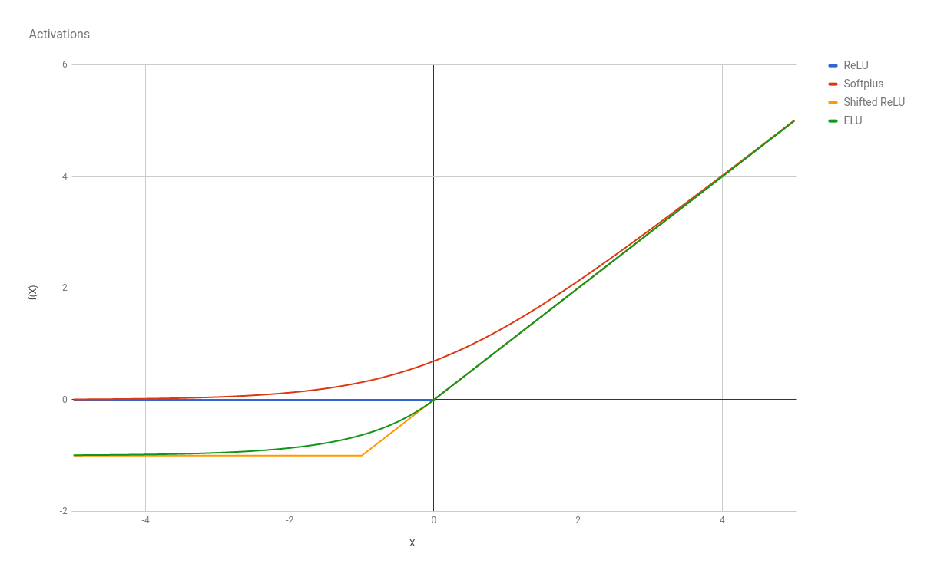
What I would Recommend: ELUs

Slide 17
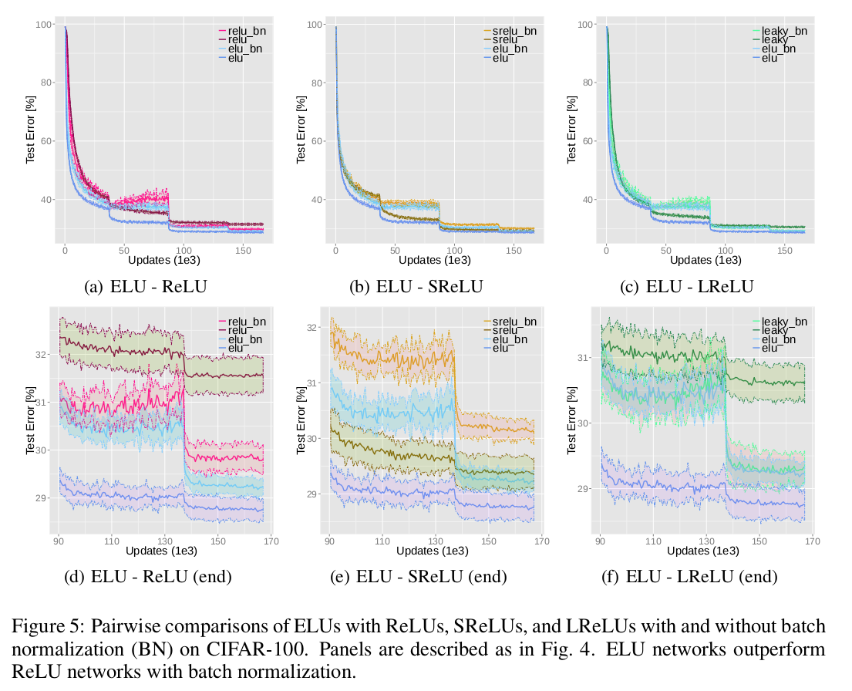
(Maybe) Better Than Batch-Norm

Slide 18
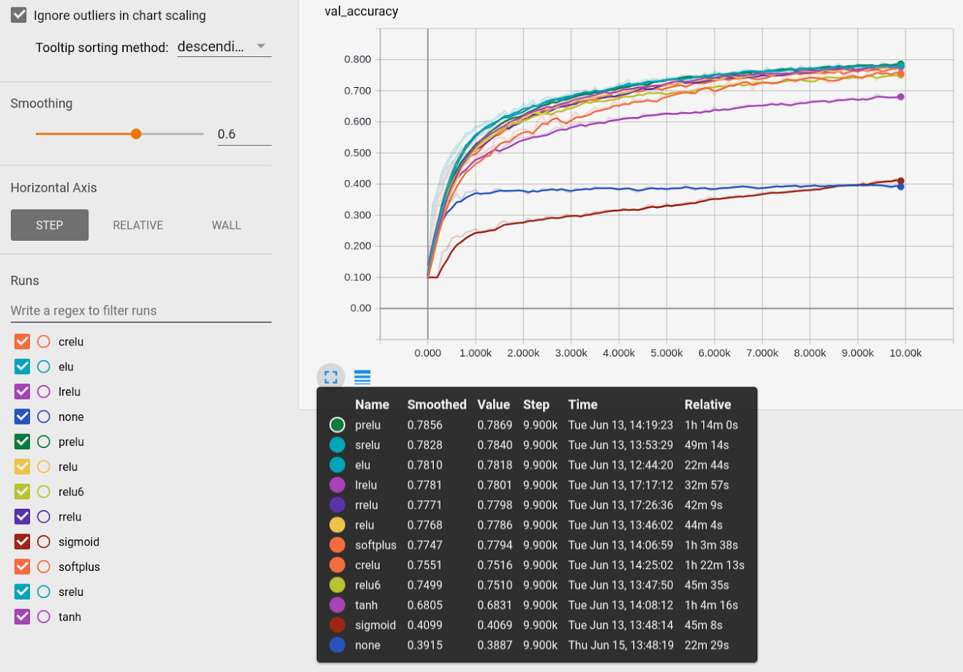
CIFAR-10

Slide 19
Papers to read
Delving Deep into Rectifiers: Surpassing Human-Level Performance on ImageNet Classification
Empirical Evaluation of Rectified Activations in Convolution Network
Understanding and Improving Convolutional Neural Networks via Concatenated Rectified Linear Units
Fast and Accurate Deep Network Learning by Exponential Linear Units (ELUs)

